Slide 1
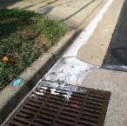
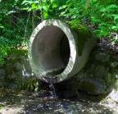
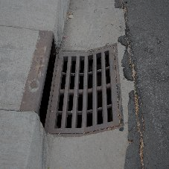
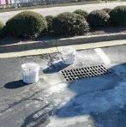
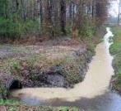
MS4 Program Overview Provided to Assist with the Department of Environmental Quality’s MS4 Program Audit April 8, 2025 Presented by: Lee F. Hixon, Ph.D., P.E. President H2R Engineering, Inc. (Program Support Consultant)

Slide 2
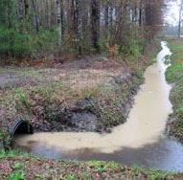
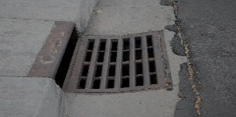
Discussion Overview
Overview │ MCM 1│ MCM 2 │ MCM 3 │ MCM 4 │ MCM 5 │ MCM 6 │ Summary
Program Overview
Administration
Regulated Campus
Program Support Documents
Minimum Control Measures
Public Education & Outreach
Public Participation/Involvement
Illicit Discharge Detection and Elimination
Construction
Post Construction
Good Housekeeping/Pollution Prevention
Impaired Local Waters
Summary & Moving Forward

Slide 3
Regulatory Background
Overview │ MCM 1│ MCM 2 │ MCM 3 │ MCM 4 │ MCM 5 │ MCM 6 │ Summary
Responsible Parties
Oversight:
Virginia Community College System
Implementation:
DCC Facilities Manager
Coordination (MCM 1 & 2)
Grounds staff oversight (MCM 3, 5 & 6)
Virginia Community College System (MCM 4 & 5)
H2R Engineering, Inc. (Support)
Nontraditional MS4
One regulated campuses
No TMDL WLAs

Slide 4
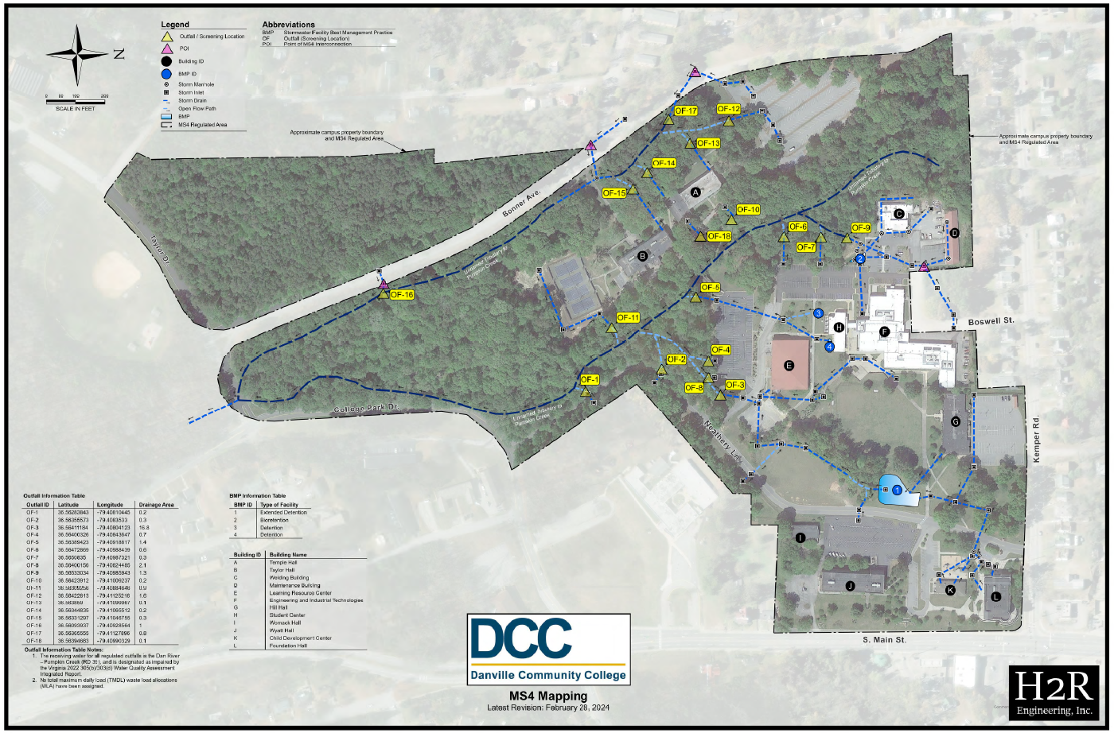
MS4 Mapping
Overview │ MCM 1│ MCM 2 │ MCM 3 │ MCM 4 │ MCM 5 │ MCM 6 │ Summary

Slide 5
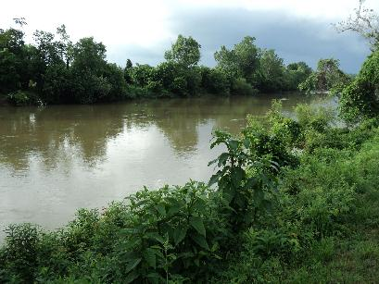
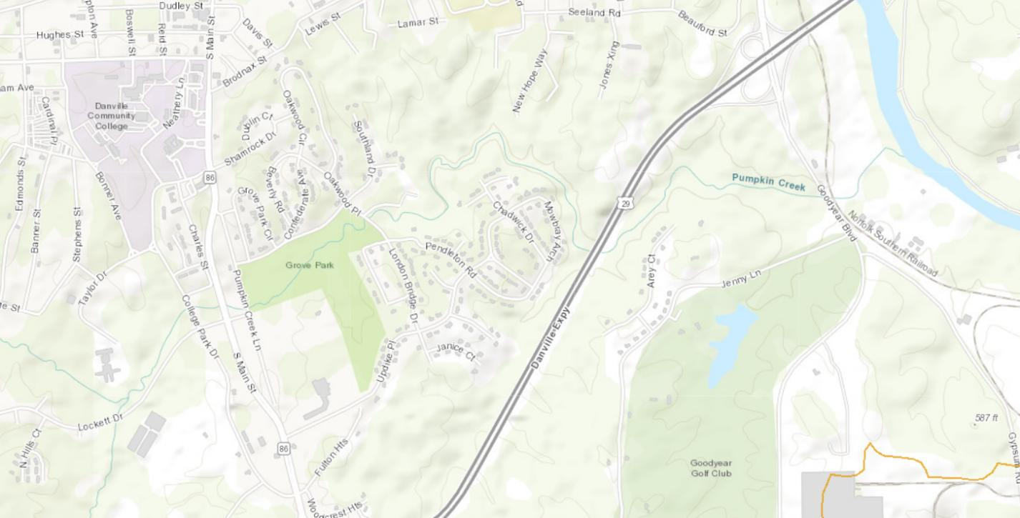
Recieving Waters
Overview │ MCM 1│ MCM 2 │ MCM 3 │ MCM 4 │ MCM 5 │ MCM 6 │ Summary
DCC → Pumpkin Creek → Dan River → Roanoke River → Albemarle Sound
Dan River impaired due to bacteria exceedances

Slide 6
Program Support Documents
Overview │ MCM 1│ MCM 2 │ MCM 3 │ MCM 4 │ MCM 5 │ MCM 6 │ Summary
MS4 Program Plan
BMPs to explicitly address each permit requirement
Documents Incorporated, by reference
MS4 Staff Handbook
IDDE Procedures
BMP Inspection Procedures
GH/PP Procedures
MS4 Map & Outfall Information Table
VCCS Stnds. & Specs. for ESC & SWM
PEOP Materials
Training Plan and Materials
Annual inspection/assessment documents

Slide 7
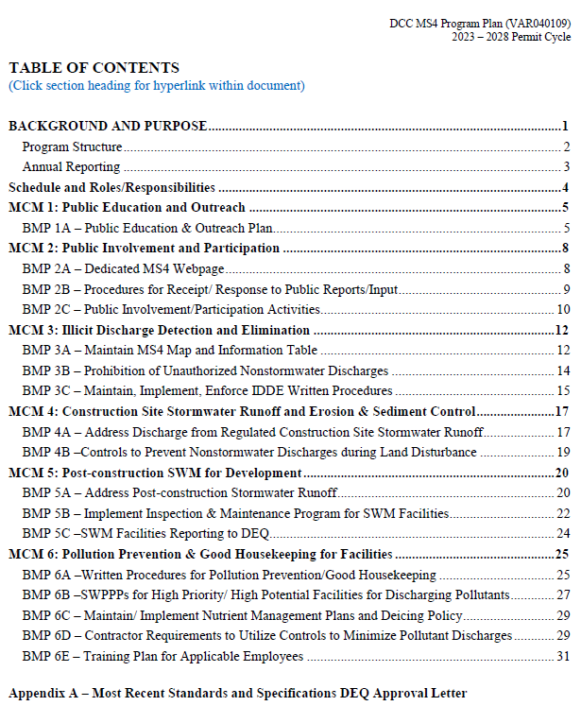
Program BMPs
Overview │ MCM 1│ MCM 2 │ MCM 3 │ MCM 4 │ MCM 5 │ MCM 6 │ Summary
Explicitly address permit requirements
BMP Components
Description
List of Necessary SOPs
Measurable Goal(s)
Annual Reporting
Requirements
Implementation Schedule

Slide 8
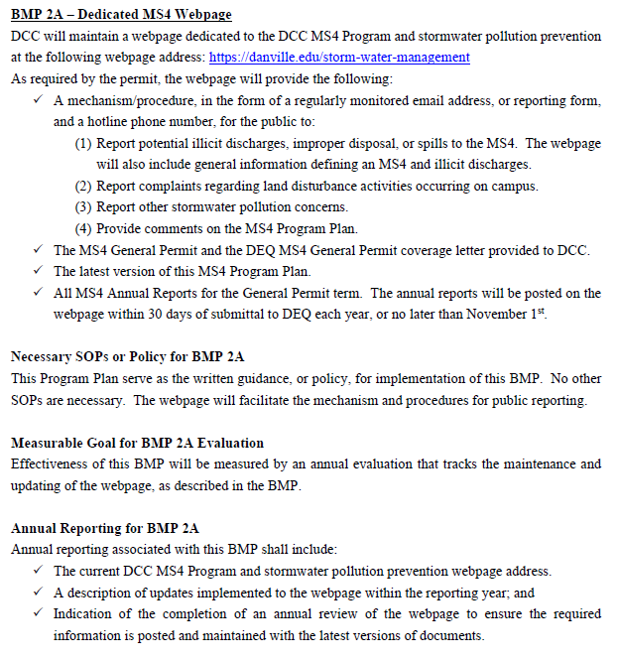
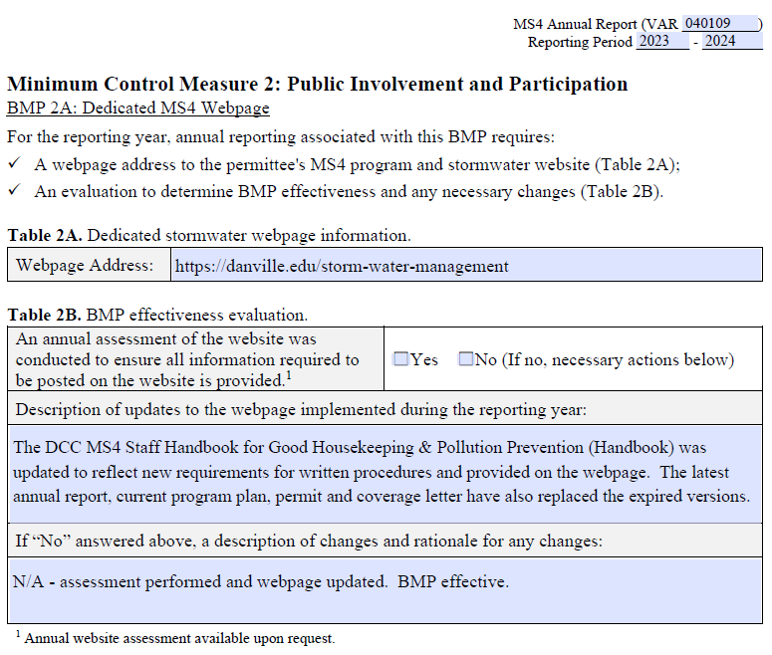
Program BMPs (Example)
Overview │ MCM 1│ MCM 2 │ MCM 3 │ MCM 4 │ MCM 5 │ MCM 6 │ Summary
Program Plan
Reporting Template

Slide 9
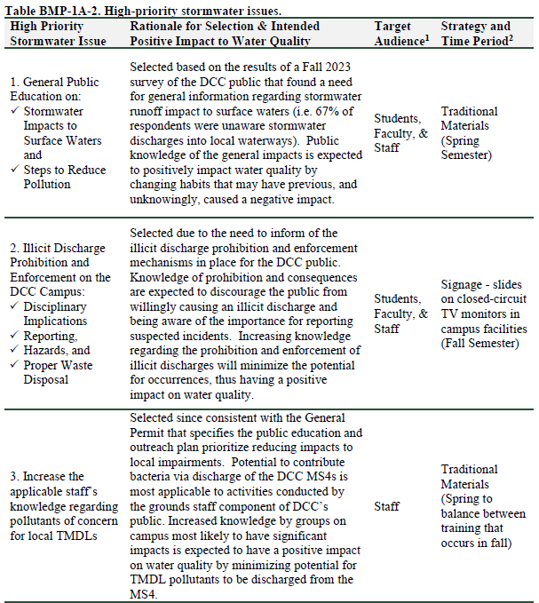
Education & Outreach Plan
Overview │ MCM 1 │ MCM 2 │ MCM 3 │ MCM 4 │ MCM 5 │ MCM 6 │ Summary
Target Audience
College public:
Students,
Faculty, &
Staff
Measure of
Effectiveness
Online survey
distribution via email

Slide 10
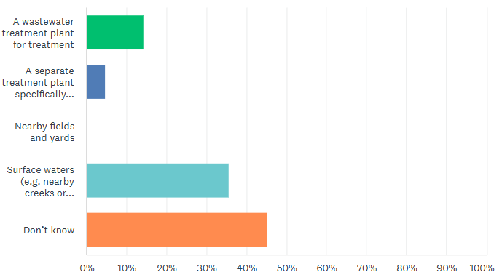
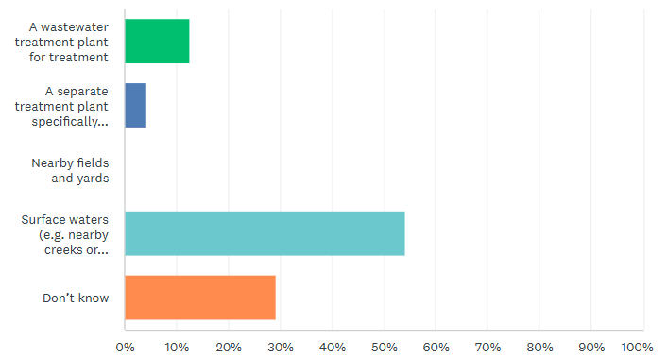
WQ Issues - Selection
Overview │ MCM 1 │ MCM 2 │ MCM 3 │ MCM 4 │ MCM 5 │ MCM 6 │ Summary
Example survey question: Stormwater from campus storm sewer drains to …
Need: General Information. (WQ Issue #1)
2023: 36% Correct
2025: 55% Correct
19% Increase!
Notes:
Was about 36% in 2021, as well.

Slide 11
WQ Issue #1
Overview │ MCM 1 │ MCM 2 │ MCM 3 │ MCM 4 │ MCM 5 │ MCM 6 │ Summary

Slide 12
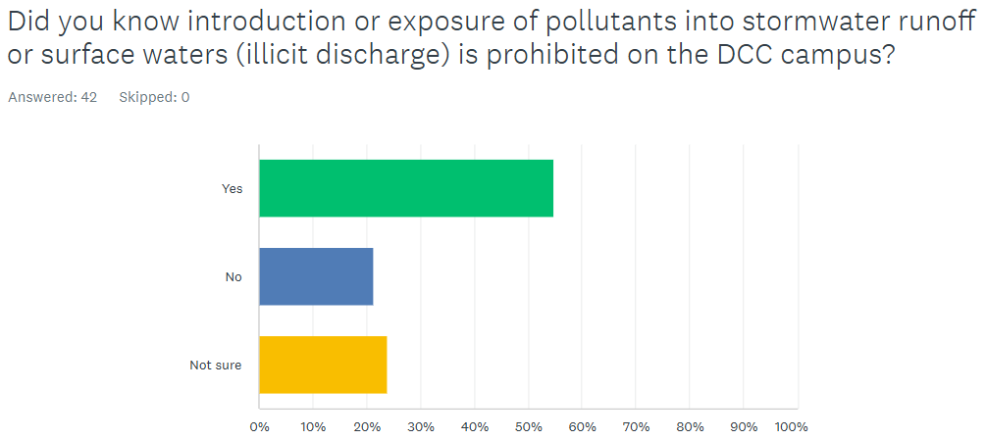
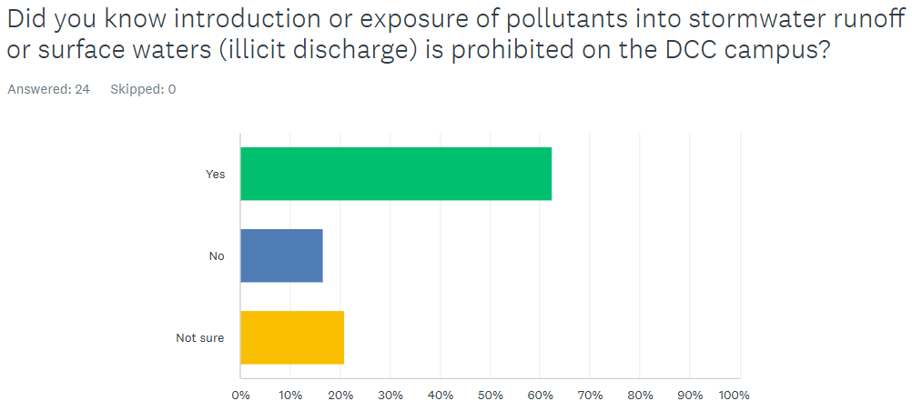
WQ Issues - Selection
Overview │ MCM 1 │ MCM 2 │ MCM 3 │ MCM 4 │ MCM 5 │ MCM 6 │ Summary
Need: Illicit Discharge education. (WQ Issue #2)
2023: 55% Correct
2025: 63% Correct
8% Increase!

Slide 13
WQ Issue #2
Overview │ MCM 1 │ MCM 2 │ MCM 3 │ MCM 4 │ MCM 5 │ MCM 6 │ Summary

Slide 14
WQ Issues #3
Overview │ MCM 1 │ MCM 2 │ MCM 3 │ MCM 4 │ MCM 5 │ MCM 6 │ Summary
Ground Staff activities have highest impact on impaired waters pollutants of concern on campuses
TMDL POC info provided between training activities
Need: Information about receiving waters and impairments.
(WQ Issue #3)

Slide 15
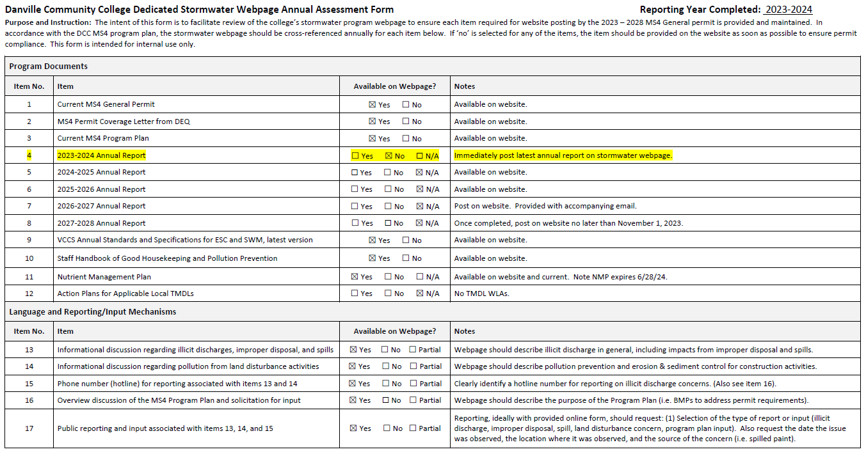
Stormwater Webpage
Overview │ MCM 1│ MCM 2 │ MCM 3 │ MCM 4 │ MCM 5 │ MCM 6 │ Summary
Required documents
Required info & reporting mechanism

Slide 16
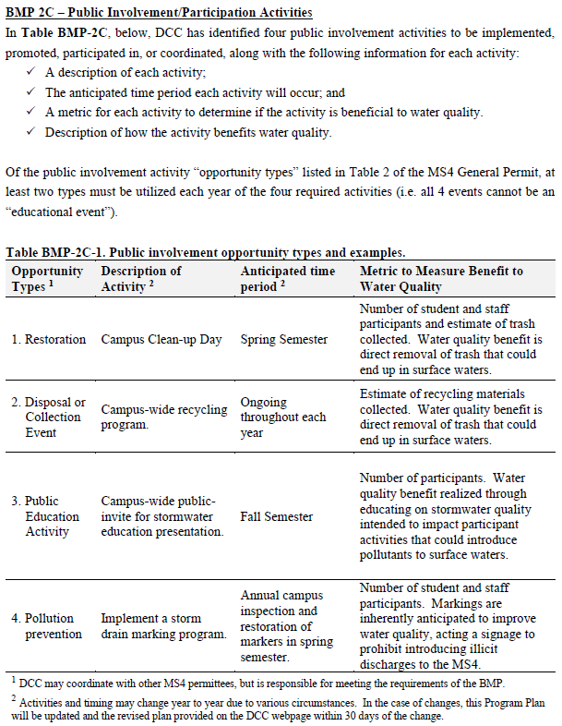
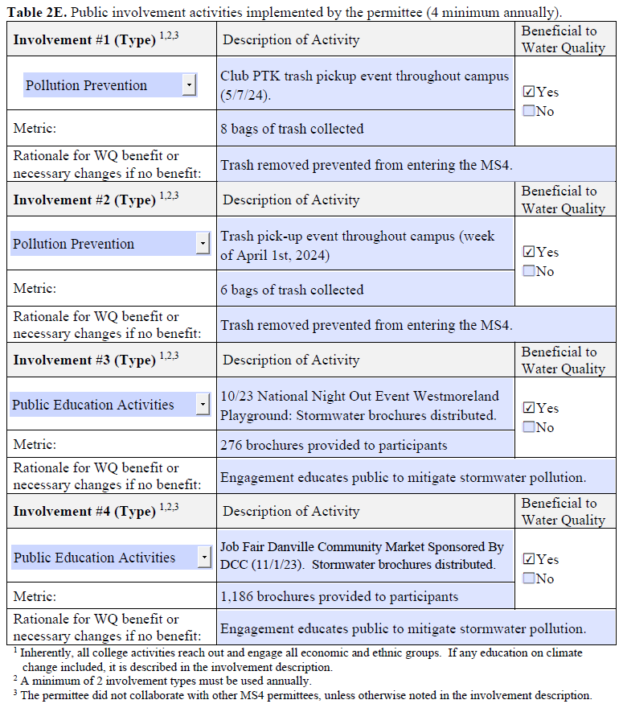
Pubic Participation
Overview │ MCM 1 │ MCM 2 │ MCM 3 │ MCM 4 │ MCM 5 │ MCM 6 │ Summary
Program Plan
Annual Reporting

Slide 17
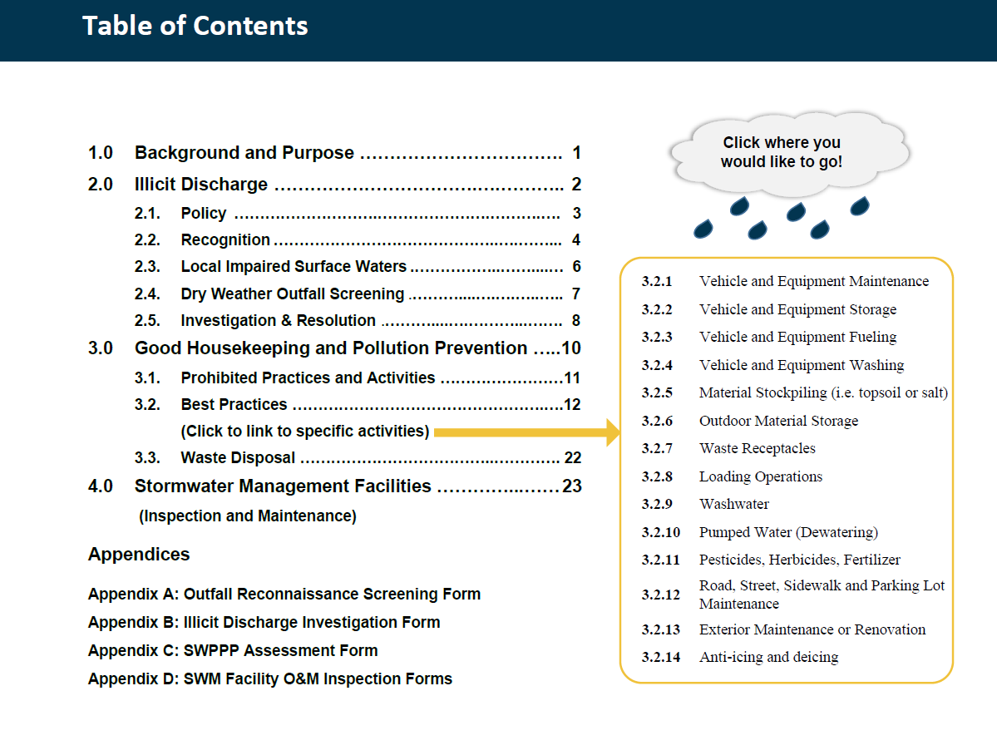
Staff Handbook for GH & PP
Overview │ MCM 1 │ MCM 2 │ MCM 3 │ MCM 4 │ MCM 5 │ MCM 6 │ Summary
Prohibition
Procedures
Forms

Slide 18
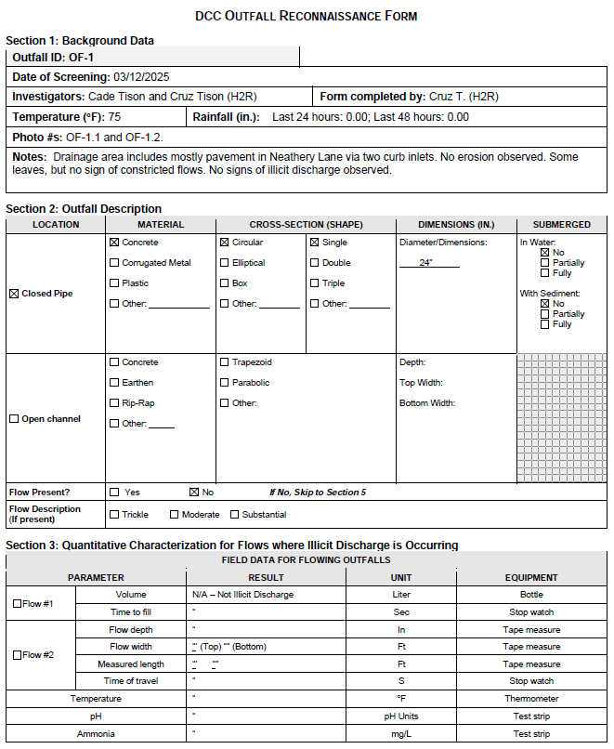
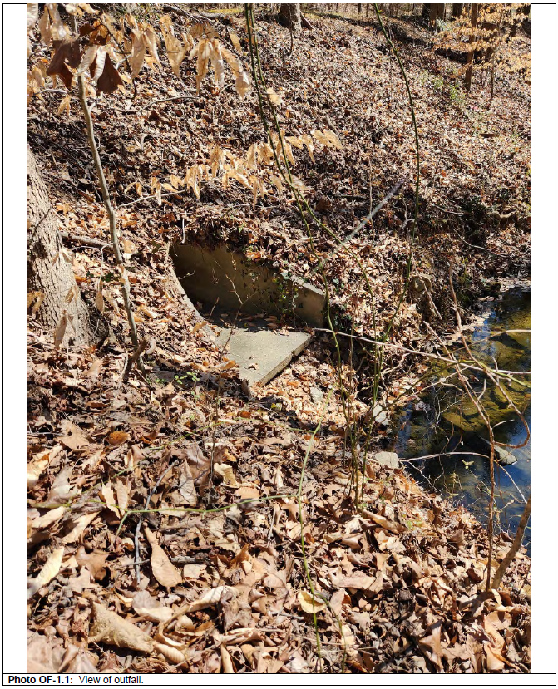
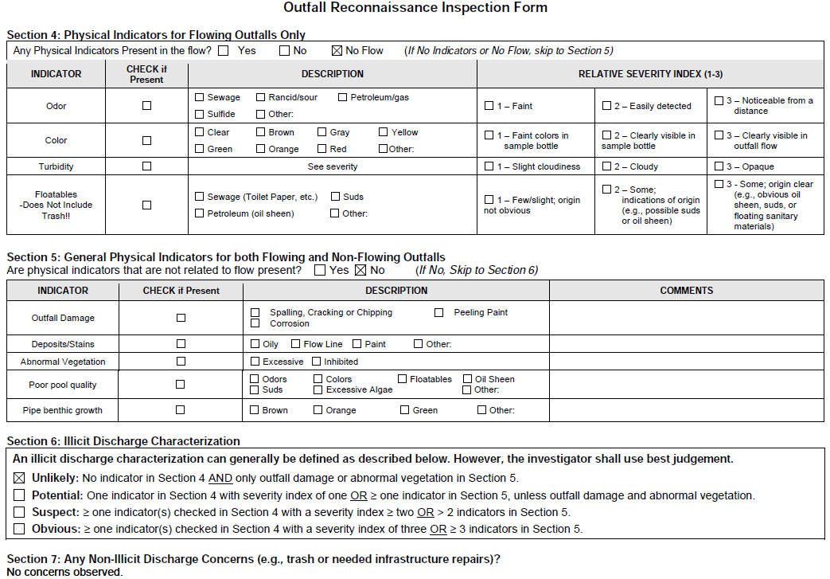
Outfall Screening Form (Example)
Overview │ MCM 1 │ MCM 2 │ MCM 3 │ MCM 4 │ MCM 5 │ MCM 6 │ Summary

Slide 19
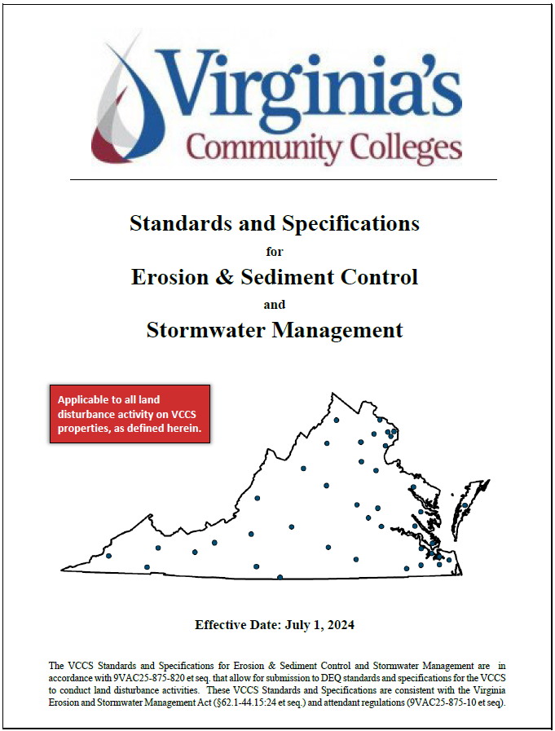
Construction Runoff Control
Overview │ MCM 1 │ MCM 2 │ MCM 3 │ MCM 4 │ MCM 5 │ MCM 6 │ Summary
Addresses ESC Regs
Contractors required to be CGP permittee & implement SWPPP
ESC inspections contracted (requires DEQ certifications)
Supporting forms for guidance & documentation

Slide 20
Post-Construction SWM
Overview │ MCM 1 │ MCM 2 │ MCM 3 │ MCM 4 │ MCM 5 │ MCM 6 │ Summary
Addresses SWM Regs
Requires long term inspections & maintenance of SWM facilities
SWM Facilities - 4 total as shown on mapping
Annually inspected and maintained to ensure intended function
Maintenance plan on BMP #2 this year

Slide 21
Post-Construction SWM
Overview │ MCM 1 │ MCM 2 │ MCM 3 │ MCM 4 │ MCM 5 │ MCM 6 │ Summary
Procedures
Forms

Slide 22
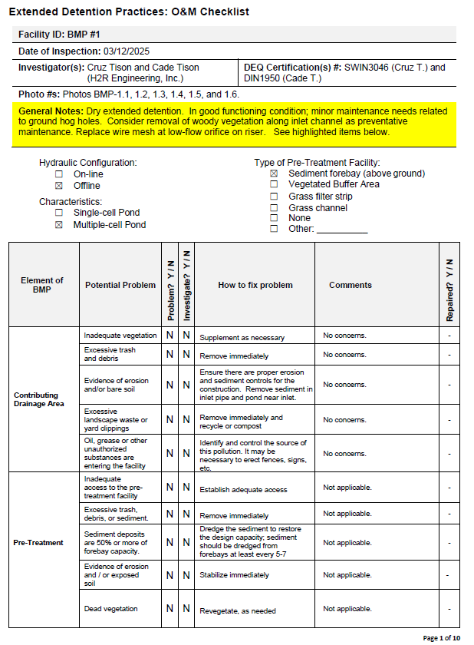
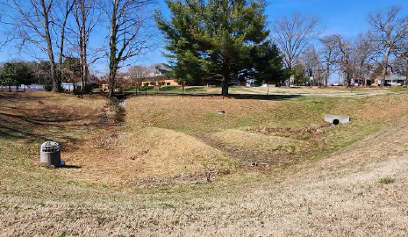
SWM Inspection Form (Example)
Overview │ MCM 1 │ MCM 2 │ MCM 3 │ MCM 4 │ MCM 5 │ MCM 6 │ Summary

Slide 23
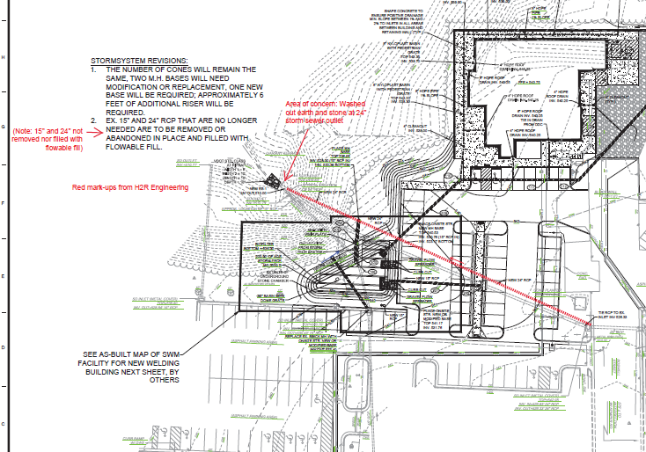
SWM Inspection BMP 2
Overview │ MCM 1 │ MCM 2 │ MCM 3 │ MCM 4 │ MCM 5 │ MCM 6 │ Summary
H2R task for survey & maintenance plan this reporting period.

Slide 24
Staff Handbook for GH & PP
Overview │ MCM 1 │ MCM 2 │ MCM 3 │ MCM 4 │ MCM 5 │ MCM 6 │ Summary
Training
Procedures
Forms

Slide 25
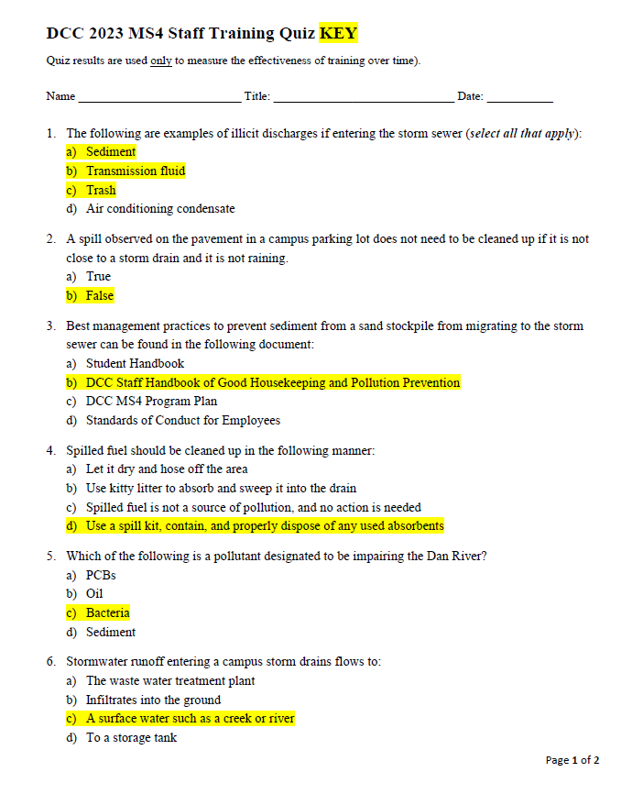
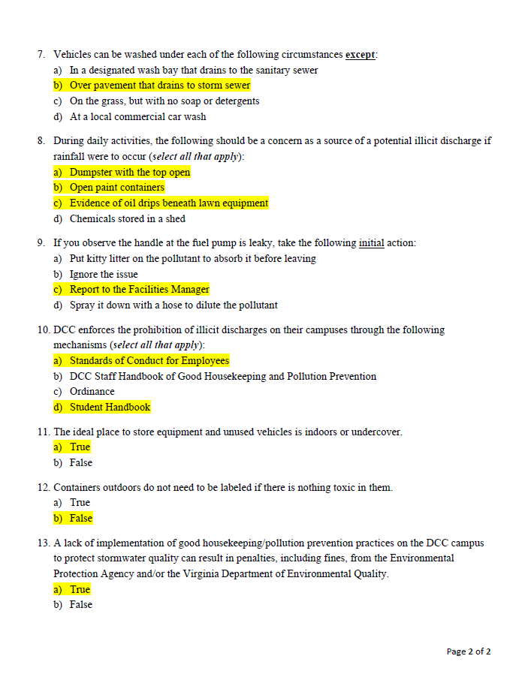
Staff Training
Overview │ MCM 1 │ MCM 2 │ MCM 3 │ MCM 4 │ MCM 5 │ MCM 6 │ Summary

Slide 26
Staff Training
Overview │ MCM 1 │ MCM 2 │ MCM 3 │ MCM 4 │ MCM 5 │ MCM 6 │ Summary
Program Plan
MS4 Permit
Implementation (Compliance and
documentation)
Supporting Materials
Training

Slide 27
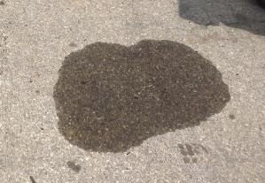
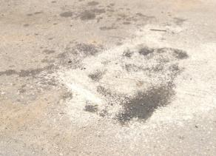
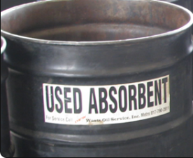
Staff Training
Overview │ MCM 1 │ MCM 2 │ MCM 3 │ MCM 4 │ MCM 5 │ MCM 6 │ Summary
Spill Response Guidance
Training
DCC GH/PP Handbook
Use absorbent
Scrub with broom
Remove prior to rainfall
Training
Implementation
Compliance to the Maximum Extent Practicable
Documentation
Disposal Guidance

Slide 28
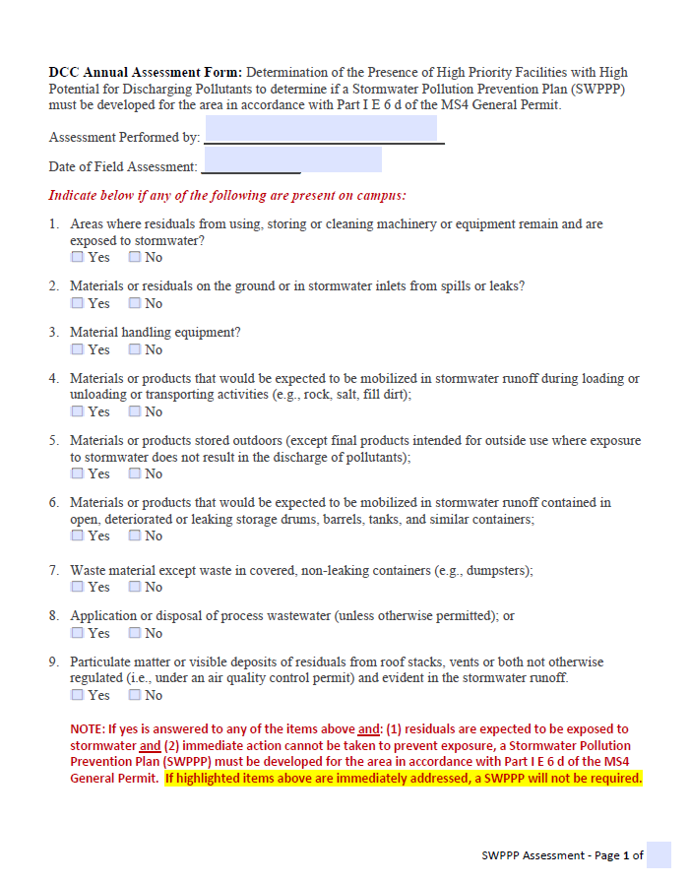
SWPPP Assessment & NMP
Overview │ MCM 1 │ MCM 2 │ MCM 3 │ MCM 4 │ MCM 5 │ MCM 6 │ Summary
High priority facility criteria not triggered with campus activities
No SWPPP required
Each campus annually evaluated
Actions needed identified
DCC does not apply nutrients on campus.

Slide 29
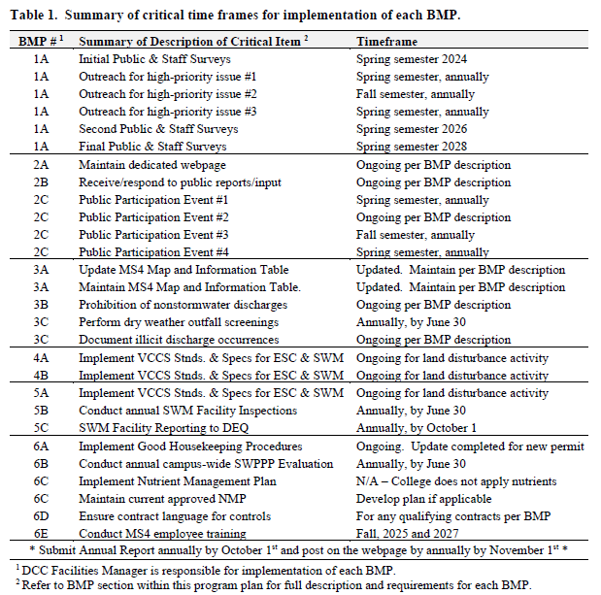
Moving Forward
Overview │ MCM 1 │ MCM 2 │ MCM 3 │ MCM 4 │ MCM 5 │ MCM 6 │ Summary
Continued program implementation
BMP #2 Maintenance Plan with cost estimate, bidding & repairs
MS4 Training prior to September
All program updates complete for current permit

Slide 30
Questions?
All DCC MS4 Program Documentation Readily Available Upon Request

